Slide 1
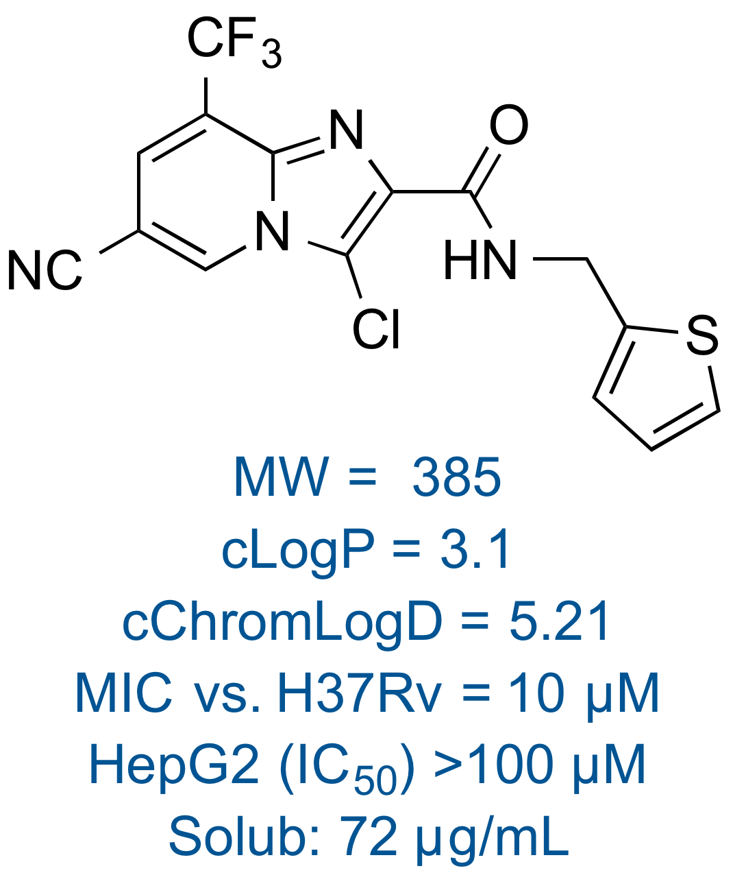
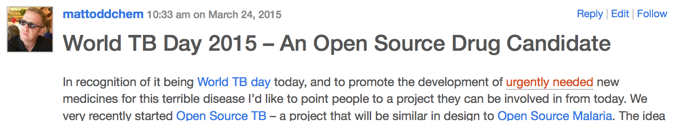
OSTB – Series 2 – The Hit
22/33
Predicted Targets:
1) O06266 (an epoxide hydrolase)
2) A2VJ47 (an epoxide hydrolase ephB) 3) P64411 (Heat shock protein 90)
4) P96222 (Mtb HTH-type transcriptional regulator Eth)
See also: Rebollo-Lopez MJ et al. (2015) Release of 50 new, drug-like compounds and their computational target predictions for open source anti-tubercular drug discovery. PLoS ONE 10(12): e0142293. doi:10.1371/journal.pone.0142293
GSK Tres Cantos, J. Overington and M. Marti-Renom, Unpublished 2015

Slide 2
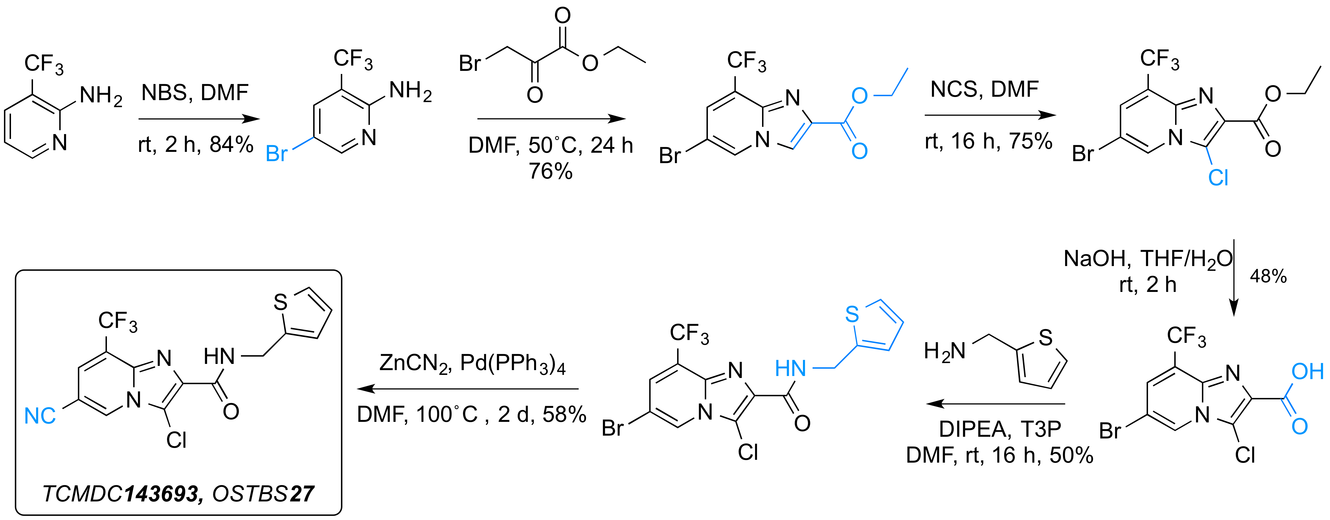
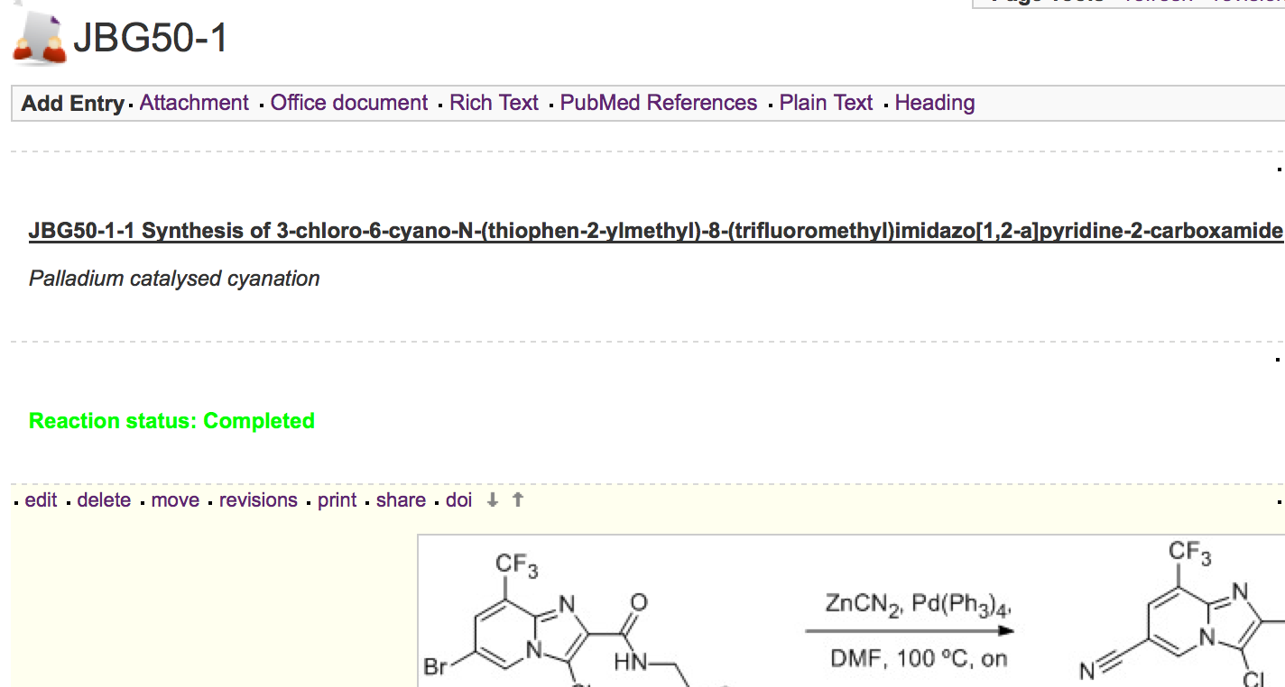
OSTB – Series 2 – Resynthesis
23/33
All experiments and data available online
http://bit.ly/1FfVvna
J. Baiget, M. Alonso, J. Castro-Pichel and M. H. Todd, Unpublished 2015

Slide 3
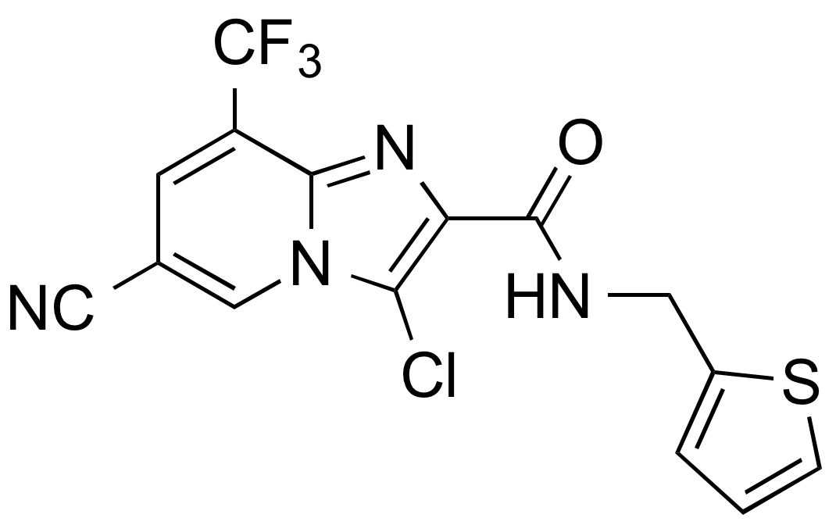
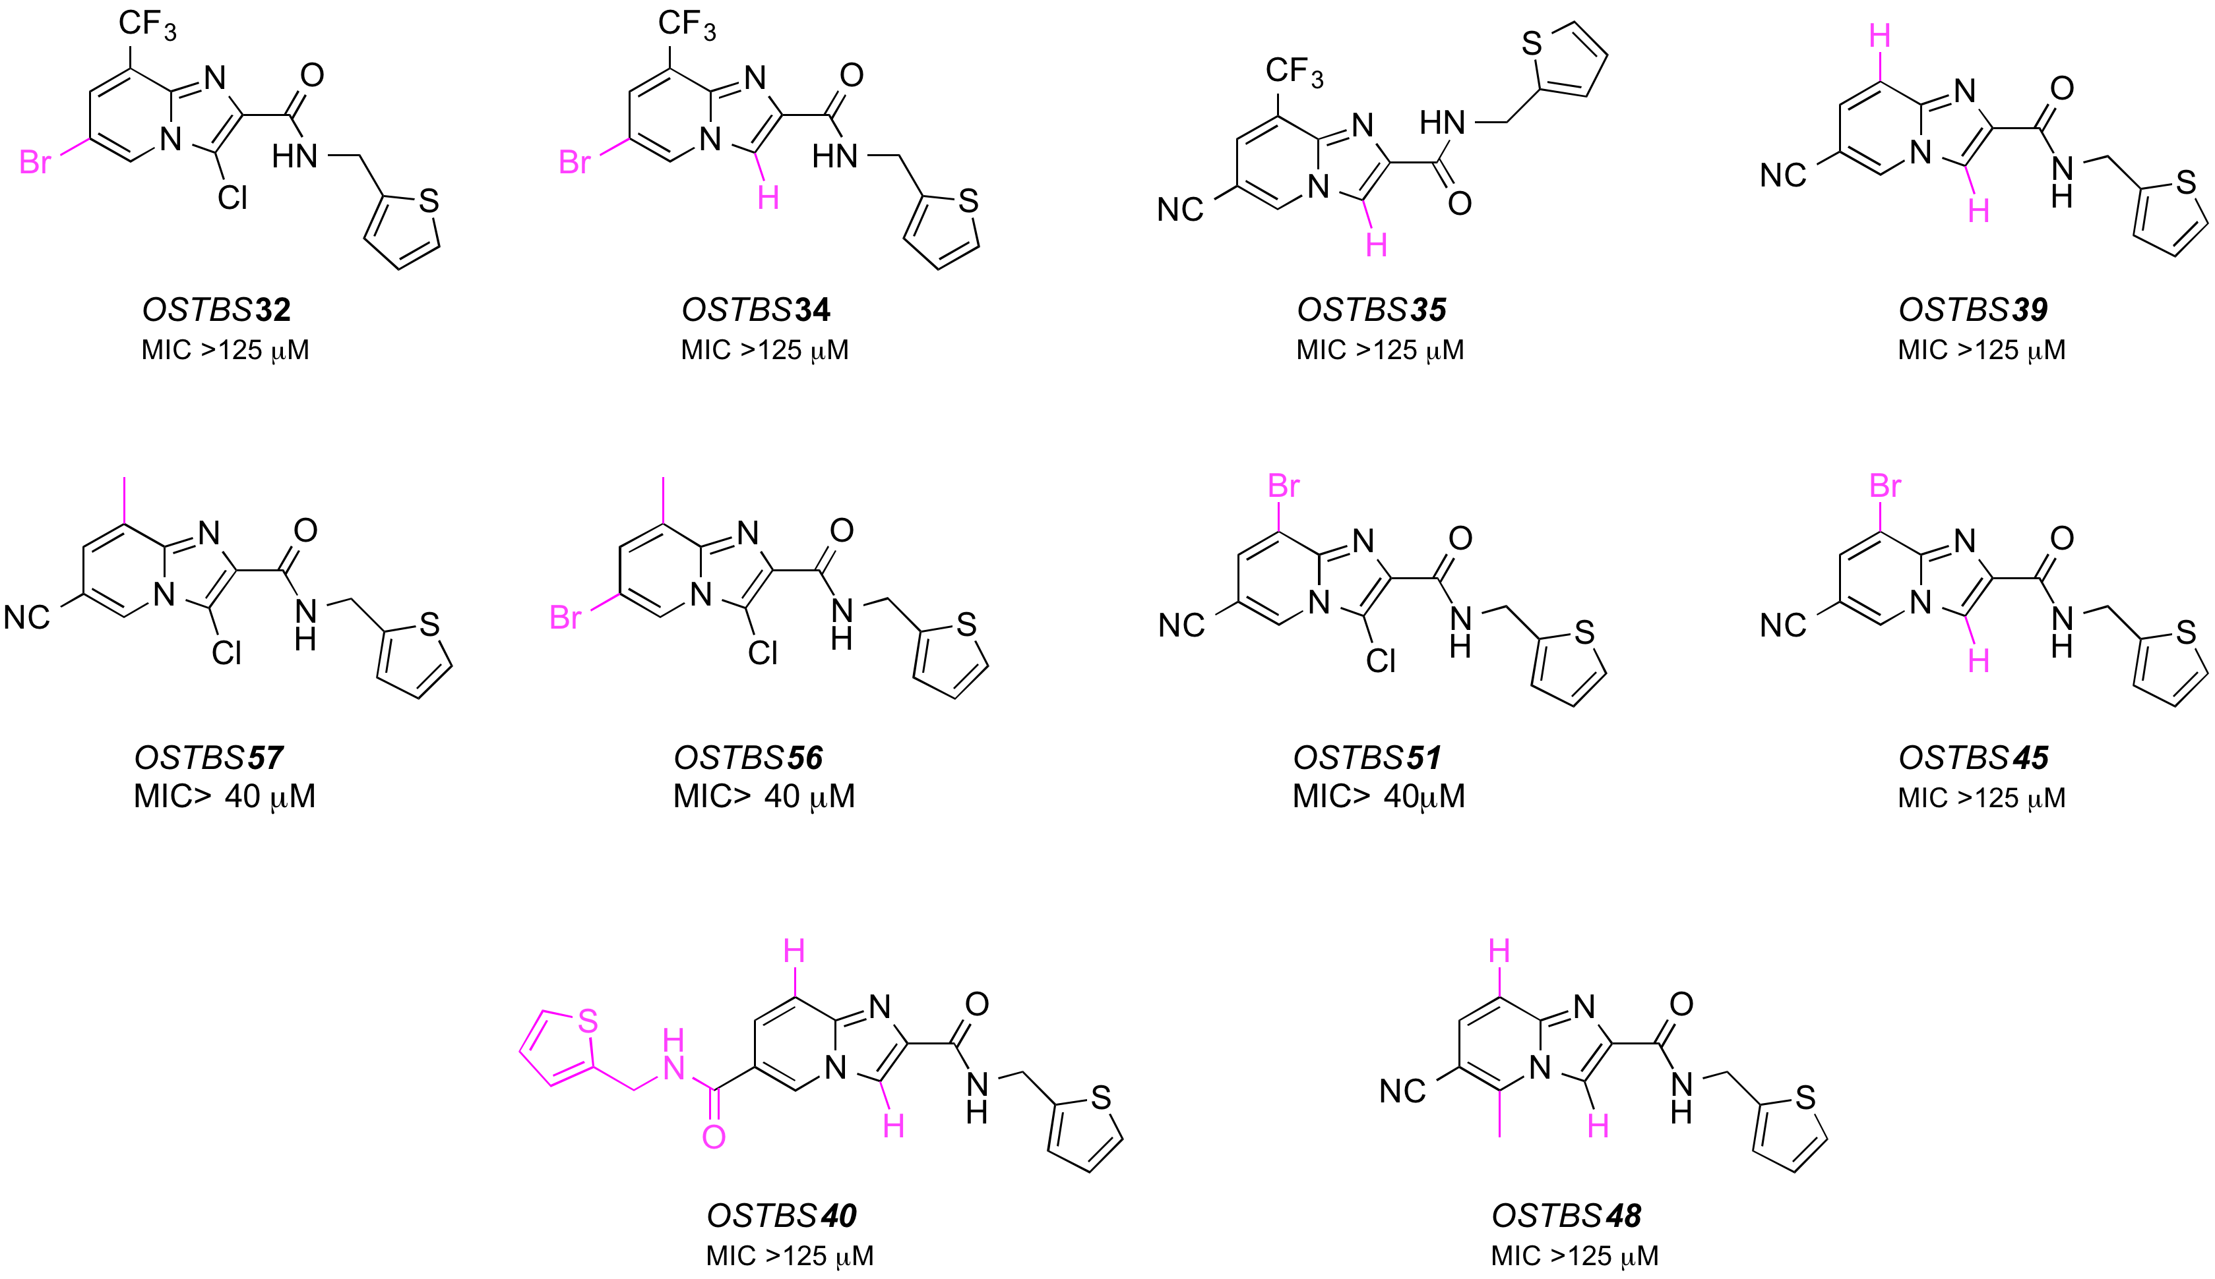
OSTB – Series 2 – Analogging
24/33
J. Baiget, M. Alonso, J. Castro-Pichel and M. H. Todd, Unpublished 2015

Slide 4
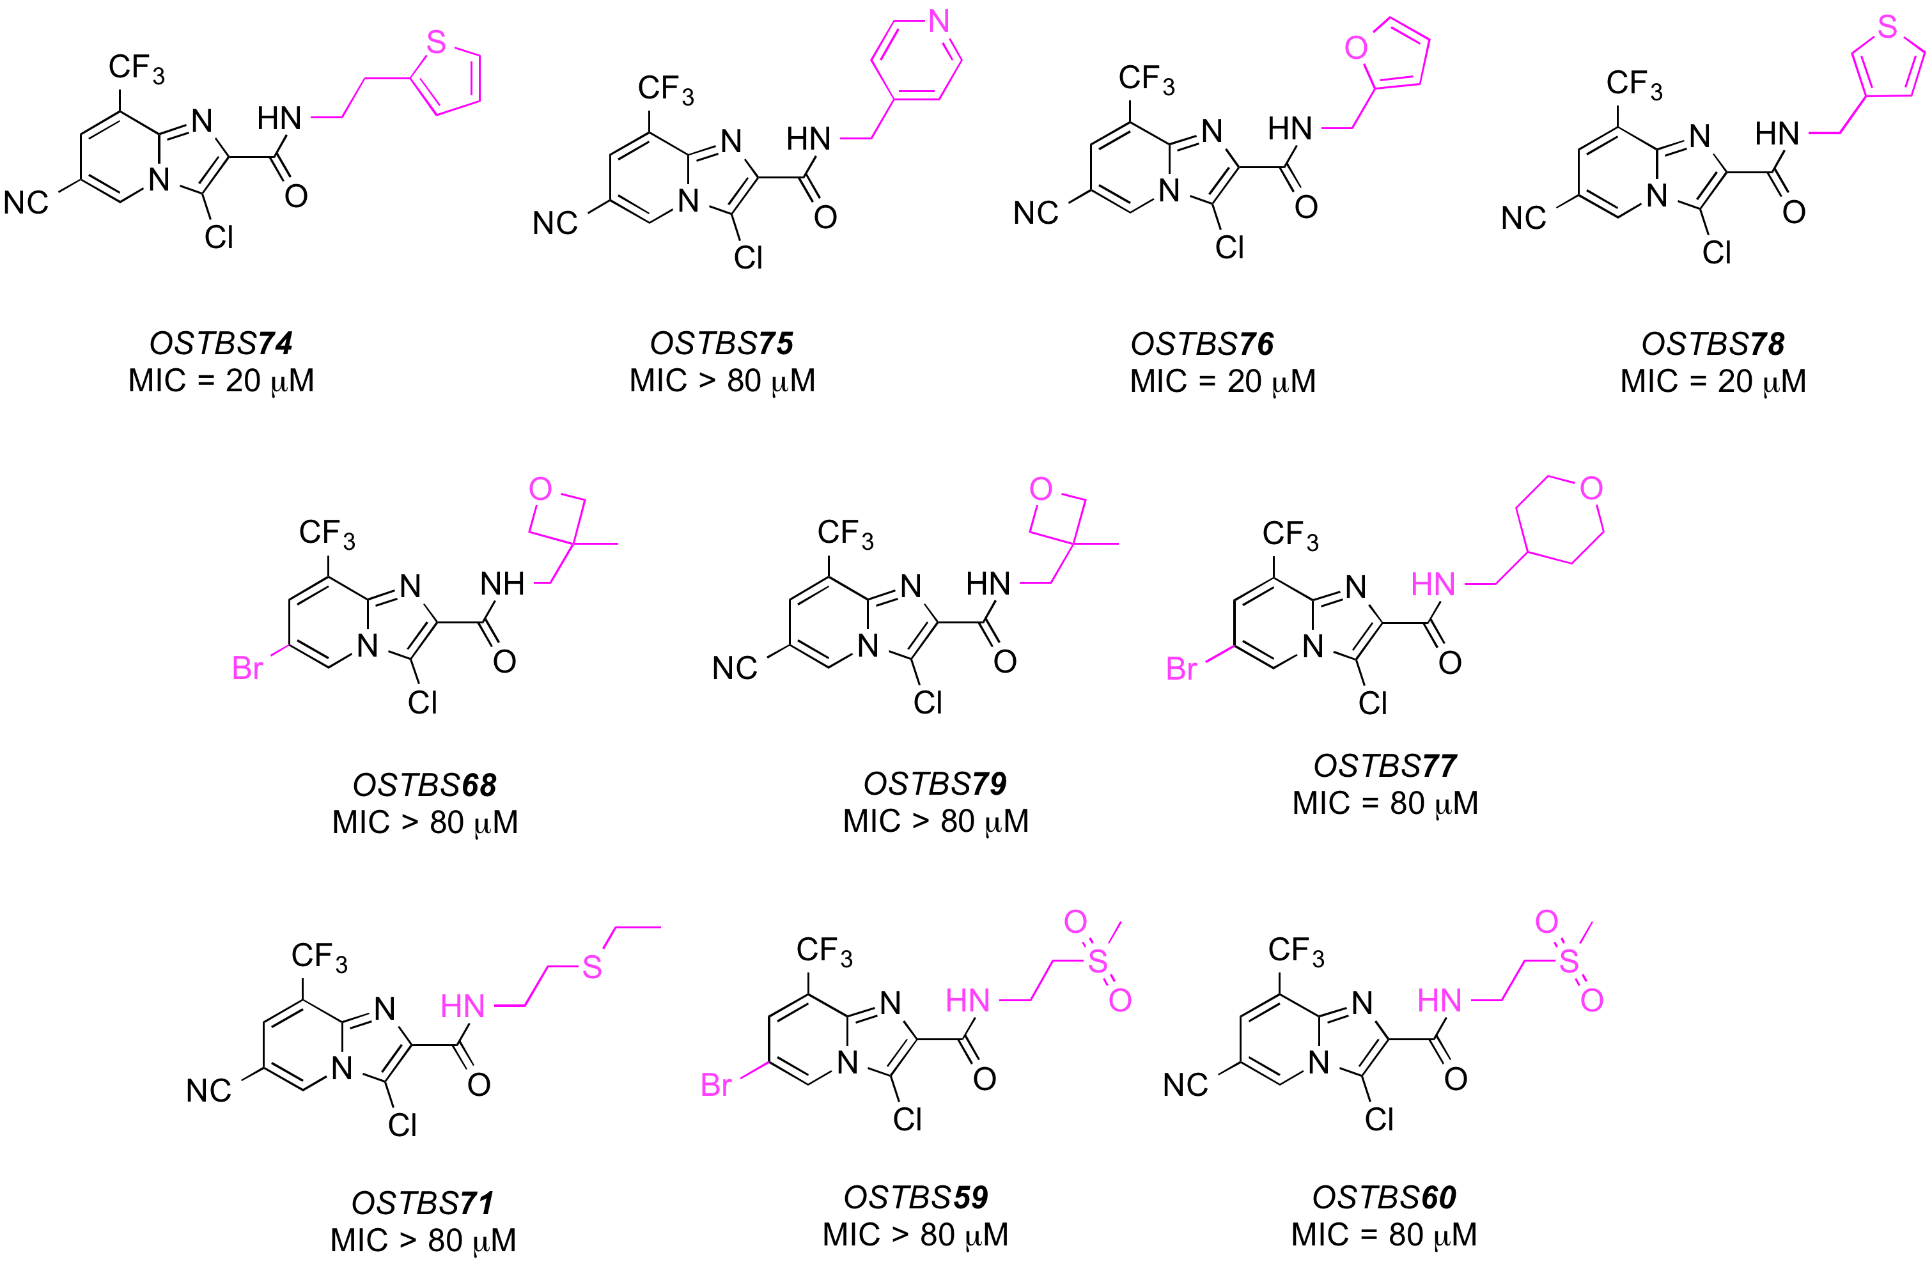
OSTB – Series 2 – Analogging
25/33
J. Baiget, M. Alonso, J. Castro-Pichel and M. H. Todd, Unpublished 2015

Slide 5
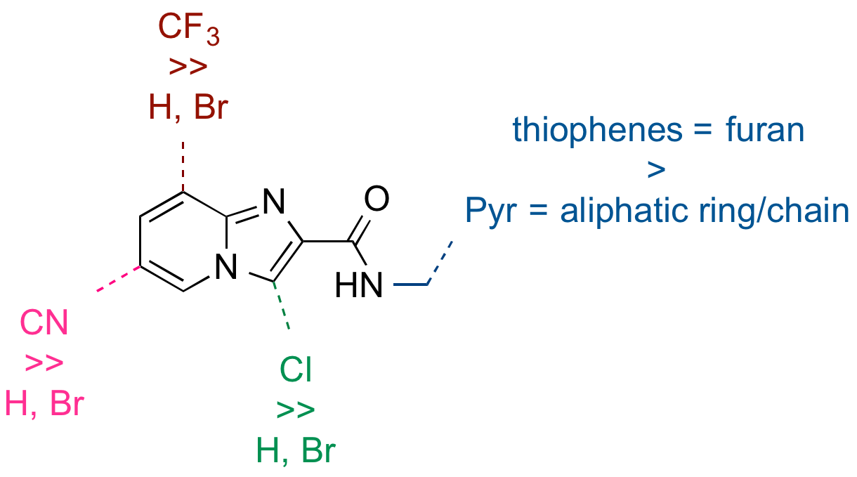
OSTB – Series 2 – Overall
26/33
Series remains available for anyone to pursue
J. Baiget, M. Alonso, J. Castro-Pichel and M. H. Todd, Unpublished 2015

